Slide 1
Express Web Application Framework

Slide 2
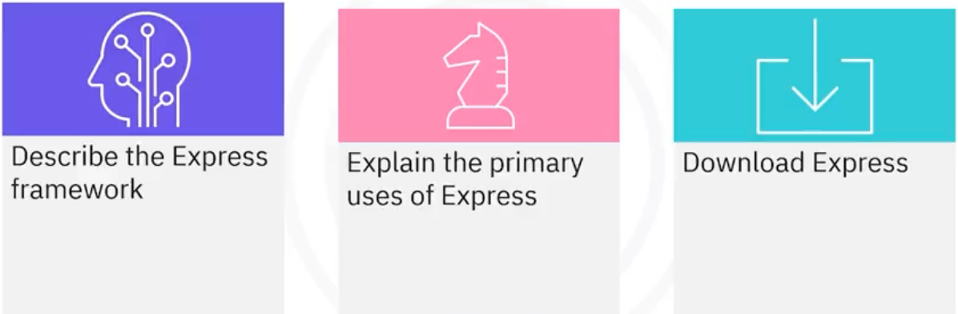
What you will learn

Slide 3
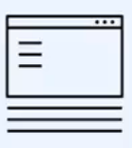
Application framework for Node.js
• Express is a third-party module that provides a framework for
building web applications
• The Express web application framework is one of the most
popular building blocks for web applications

Slide 4

Two purposes of Express
•As an API
•Setup templates with
server-side rendering
(SSR)

Slide 5
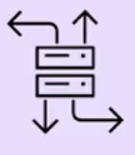
APIs with Express
• An Express API sets up an HTTP
interface to interact with the data layer
of the application
• Data is sent back to the client in JSON
format using a response, or res, object
• The res.json() method:
• Notifies the client of the content type
being sent
• Stringify data

Slide 6

SSR with Express
• SSR is used to create templates
• Data is sent from the client to the
server
• Templates use that data to create
HTML, CSS, JavaScript
• Use the res.render() method

Slide 7
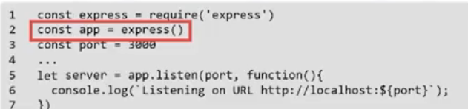
Application framework for Node.js
• Express implements an app class that you map to a web
resource path
• The standard Node.js framework treats HTTP requests at a
lower network level
• The http.createServer function relies on a custom callback
function to parse through the web resource path

Slide 8
How Express works
Declare Express as a dependency in the package manifest of a Node.js project
Run the npm command to download any missing modules
Import the Express module and create an Express application
Create a new route handler
Start an HTTP server on a given port number
1 Declare
2 Install
3 Require
4 create
5 Start

Slide 9
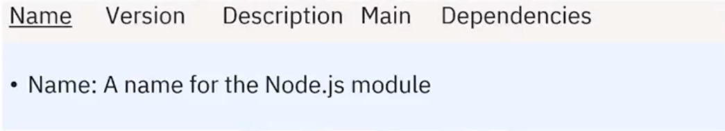
Step 1: declare as dependency
• Create a package . json file in your project folder
• The package .json file stores information about
the contents of a Node.js module
1 Declare

Slide 10
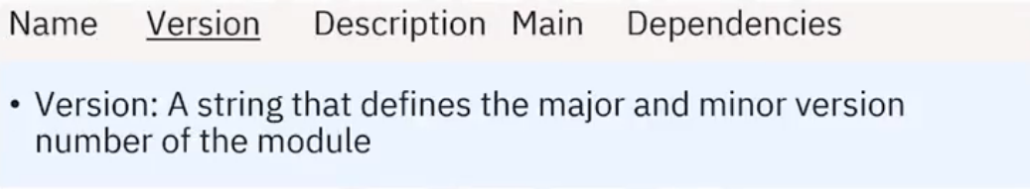
Step 1: declare as dependency
• Create a package . json file in your project folder
• The package .json file stores information about
the contents of a Node.js module
1 Declare

Slide 11
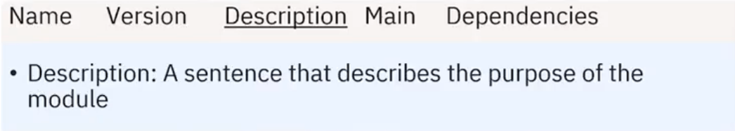
Step 1: declare as dependency
• Create a package . json file in your project folder
• The package .json file stores information about
the contents of a Node.js module
1 Declare

Slide 12
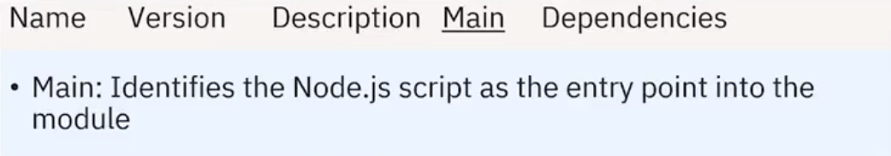
Step 1: declare as dependency
• Create a package . json file in your project folder
• The package .json file stores information about
the contents of a Node.js module
1 Declare

Slide 13
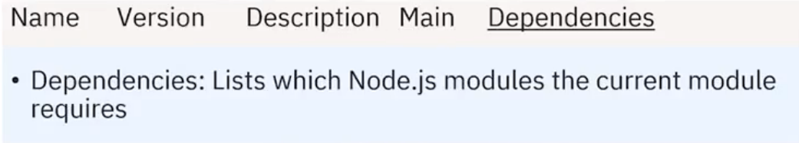
Step 1: declare as dependency
• Create a package . json file in your project folder
• The package .json file stores information about
the contents of a Node.js module
1 Declare

Slide 14
Step 1: declare as dependency
• To declare Express as a dependency, list the
Express module and a version number in the
dependencies property
1 Declare

Slide 15
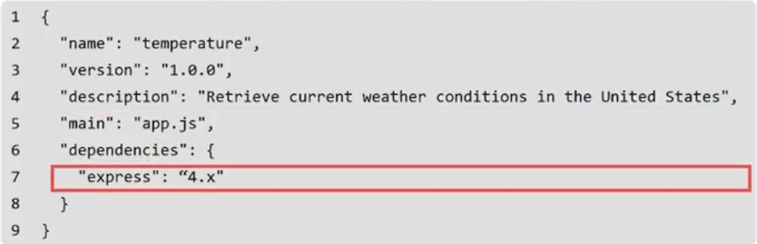
Example: dependency on Express
• This is the package .json dependency file
1 Declare

Slide 16
Step 2: run npm to download
• Run the npm install command inside the Node
module directory to resolve any missing dependent
Node modules
• The command downloads and saves any missing
Node modules into its own node module
directory
• You can use different versions of the same Node
module in different packages
2 Install
2 Install

Slide 17
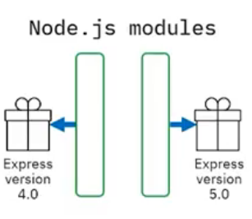
Step 2: run npm to download
• For example, a custom Node.js module
installs a version 4.0 release of the Express
framework
• Another Node.js module installs version 5.0
in its own Node.js module repository
• To install a Node.js module into the shared
node_module directory, run npm install
<module_name> from the directory with
your Node.js installation
2 Install

Slide 18
Step 2: run npm to download
• The npm command
downloads the Express
framework and all of its
dependent modules
2 Install

Slide 19
Recap
In this video, you learned that:
• Express is a third-party module that provides a framework for
building web applications
• Two purposes: APIs and SSR
• To install Express, there are five steps:
Declare Express as a dependency in the package manifest of a
Node.js project
Run the npm command to download any missing modules
Import the Express module and create an Express application
Create a new route handler
Start an HTTP server on a given port number

